Slide 1

Milestone 4: Baseline Model Trials
By Melina Lellepi and Ioannis Papadikos

Slide 2

Outline
Baseline Models:
Dummy Classifier
KNN (K-Nearest Neighbors)
Logistic Regression
Decision Tree
Evaluating Performance:
Accuracy
MSE, RMSE and MAE
Precision and Recall
F1-score

Slide 3

Baseline Models

Slide 4

Dummy Classifier
For our simplest model we used a dummy classifier, that is a simple machine learning tool that makes predictions using basic rules, without trying to learn patterns from the data by always predicting the most frequent class. We mainly used this to compare it to other models.
In a dataset where 90% of patients don’t have heart disease:
A dummy classifier using most frequent would always predict "no disease."
It might get 90% accuracy, but it’s not a useful model.

Slide 5
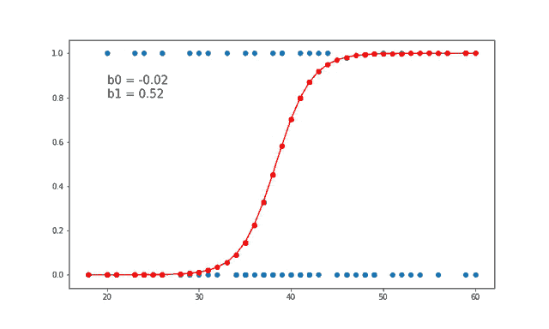
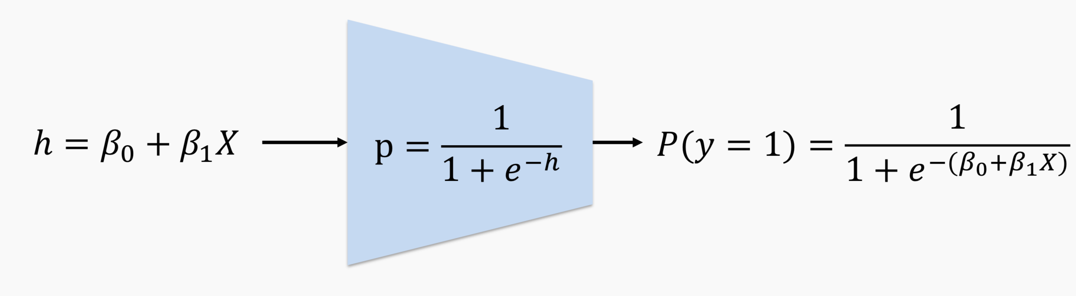
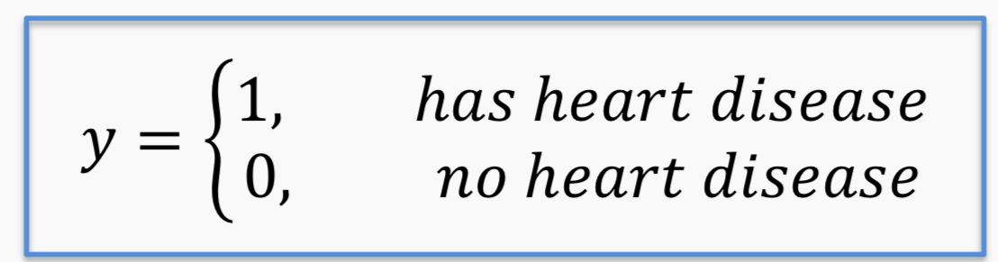
Logistic Regression
Logistic regression is a statistical method used to predict the probability of a binary outcome (like yes/no, 0/1, or true/false) based on one or more input variables. It estimates the relationship between the inputs and the probability of a specific outcome using a special "S-shaped" curve called the sigmoid/logistic function.
Linear regression could be used to predict the probability 𝑃(𝑦 = 1) directly from a set of predictors such as sex, cholesterol levels etc.
If 𝑃(𝑦 = 1) ≥ 0.5, we could predict that the patient has heart disease and predict otherwise if 𝑃(𝑦 = 1) < 0.5.

Slide 6
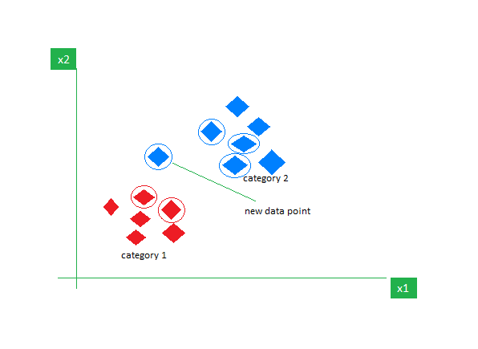
K-Nearest Neighbors (classification)
KNN for classification is a simple algorithm that predicts the class of a data point by looking at the 'k' closest labeled points in the dataset. It assigns the most common class among those neighbors.
Why we used this:
KNN predicts whether a person has heart disease by comparing their health data (like age, cholesterol, and blood pressure) to others in the dataset.
Suppose k = 3, and a new patient’s data is similar to:
2 people with heart disease
1 person without heart disease
KNN will classify this new patient as having heart disease, since the majority of the 3 nearest neighbors do.

Slide 7
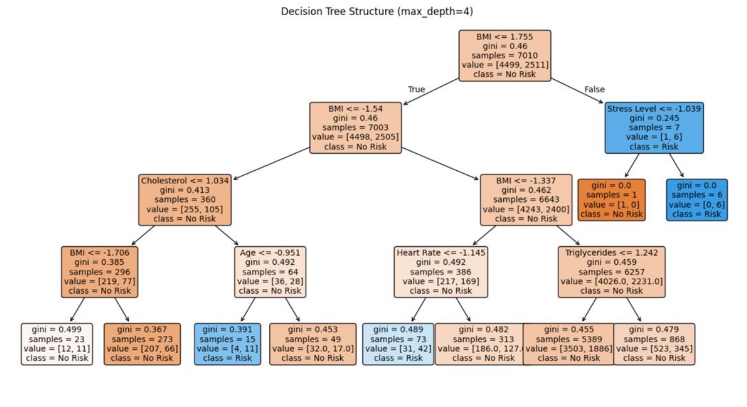
Decision Tree Classifier
Our Decision Tree
A decision tree classifier predicts class labels by splitting data based on features, creating a tree structure. These splits form decision boundaries that separate classes for classification.
Why we used it:
Handles different data types: It works well with both numerical data (e.g., age, cholesterol) and categorical data (e.g., family history).
Provides clear risk categories: By splitting data into groups, it helps identify patients at high or low risk clearly.
No need for much data preprocessing: Decision trees don’t require scaling or normalization.

Slide 8
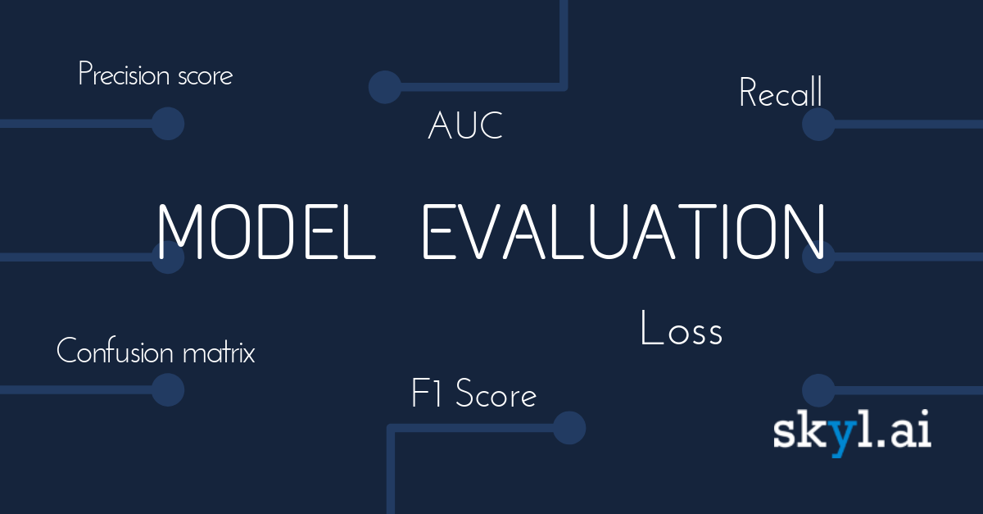

Slide 9
The metrics
Accuracy – % of correct predictions
Precision – How many predicted positives are correct
Recall – How many actual positives are found
F1 Score – Balance between precision and recall
Confusion Matrix – Detailed breakdown of prediction results

Slide 10
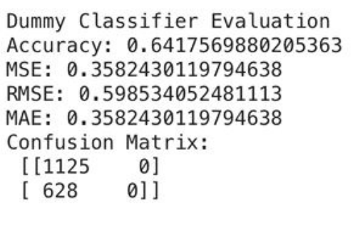
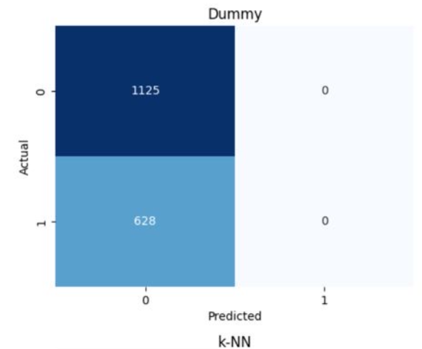
Dummy Classifier: Results and Metrics

Slide 11
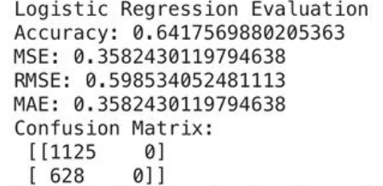
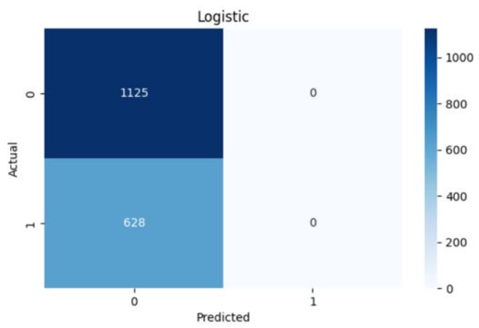
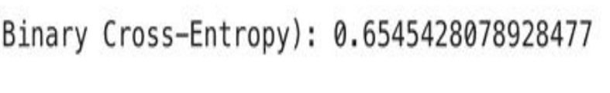
Logistic Regression: Results and Metrics

Slide 12
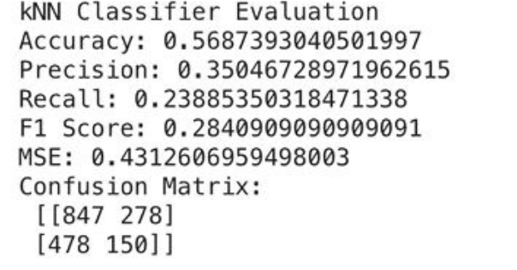
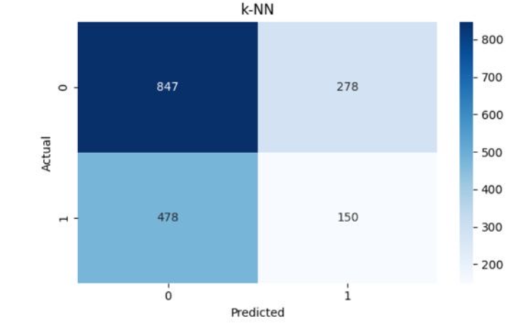
K-Nearest Neighbors: Results and Metrics

Slide 13
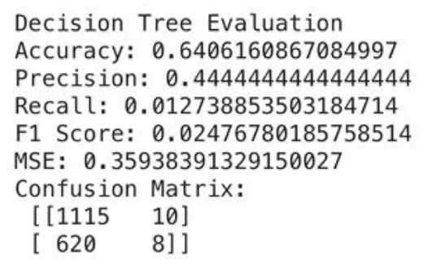
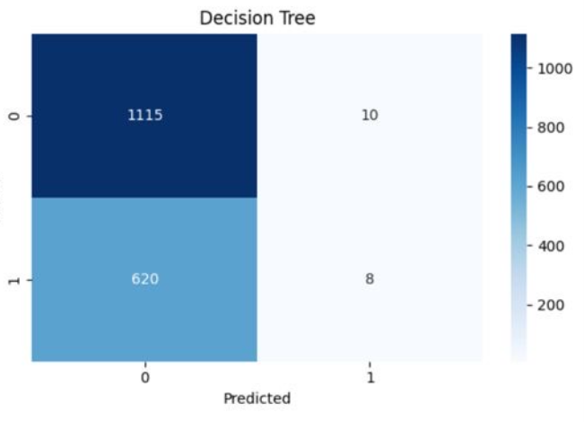
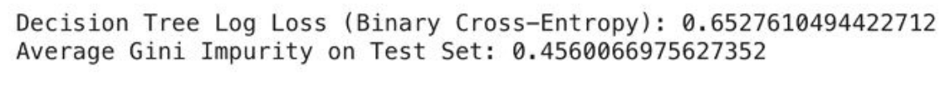
Decision Tree Classifier: Results and Metrics

Slide 14
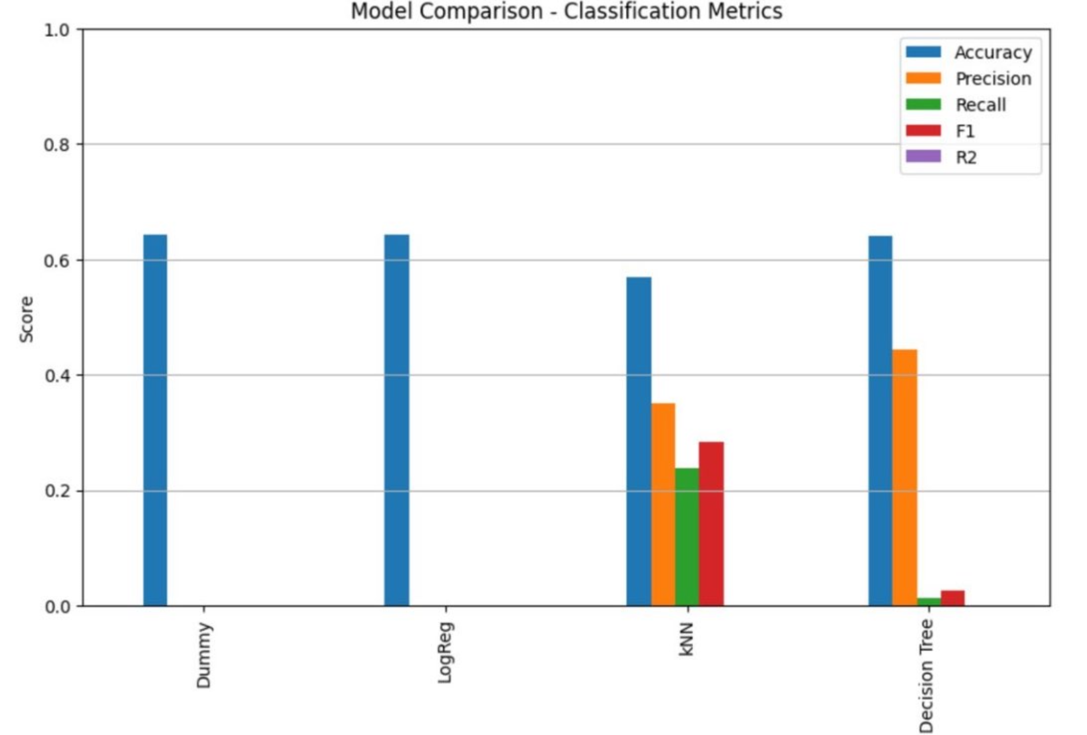
Model Evaluation

Slide 15

What Surprised Us and Insights
Logistic Regression performed identically to the Dummy Classifier.
As expected the Decision tree classifier had the highest accuracy, however a much lower F1 score in comparison to KNN.
KNN had the lowest accuracy, but the highest F1 score (by a large margin).
Recall was most at KNN as it predicted most true positives.

Slide 16
How we’re planning to improve
Use of more complex models such as XGBoost and Random Forests.
Ensuring data is well cleaned.
More Stopping conditions/hyper-parameters to be applied to our models.
ROC-AUC to be implemented to give us a better visualization of model performance.

Slide 17

Thank you for your attention!

